Slide 1
Couch Guardian
ThePerfect10

Slide 2
Agenda
Team Introduction
Purpose, Motivation, Target Audience
System Implementation
Features
Non-Functional Requirements
Lessons Learned
Collaboration Tools
Product Demostration

Slide 3


Team Introduction
Group Details
Group 10 aka thePerfect10
Couch Guardian smart device
YouTube link: https://youtu.be/2tebSB6xQng
Team Members
David Batson – Product Owner
Tsz Shing Tsoi – Scrum Master
Francis Iniobong John Ifon – Individual Contributor
Alyssa Johnson – Individual Contributor

Slide 4
Purpose, Motivation, & Target Audience
Purpose
Stop bad pet behavior
Motivation
Save pet owners money by preventing damage
Target Audience
Veteran and new pet owners
Pet owners with an interest in IoT
Log the bad behavior for rehabilitation measures
Notify the pet owner of the bad behavior happening

Slide 5
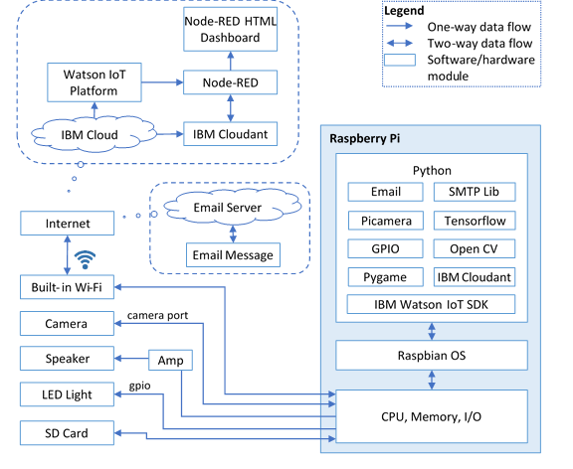
System
Architecture
Software Structure
IoT Integration
Physical Components

Slide 6
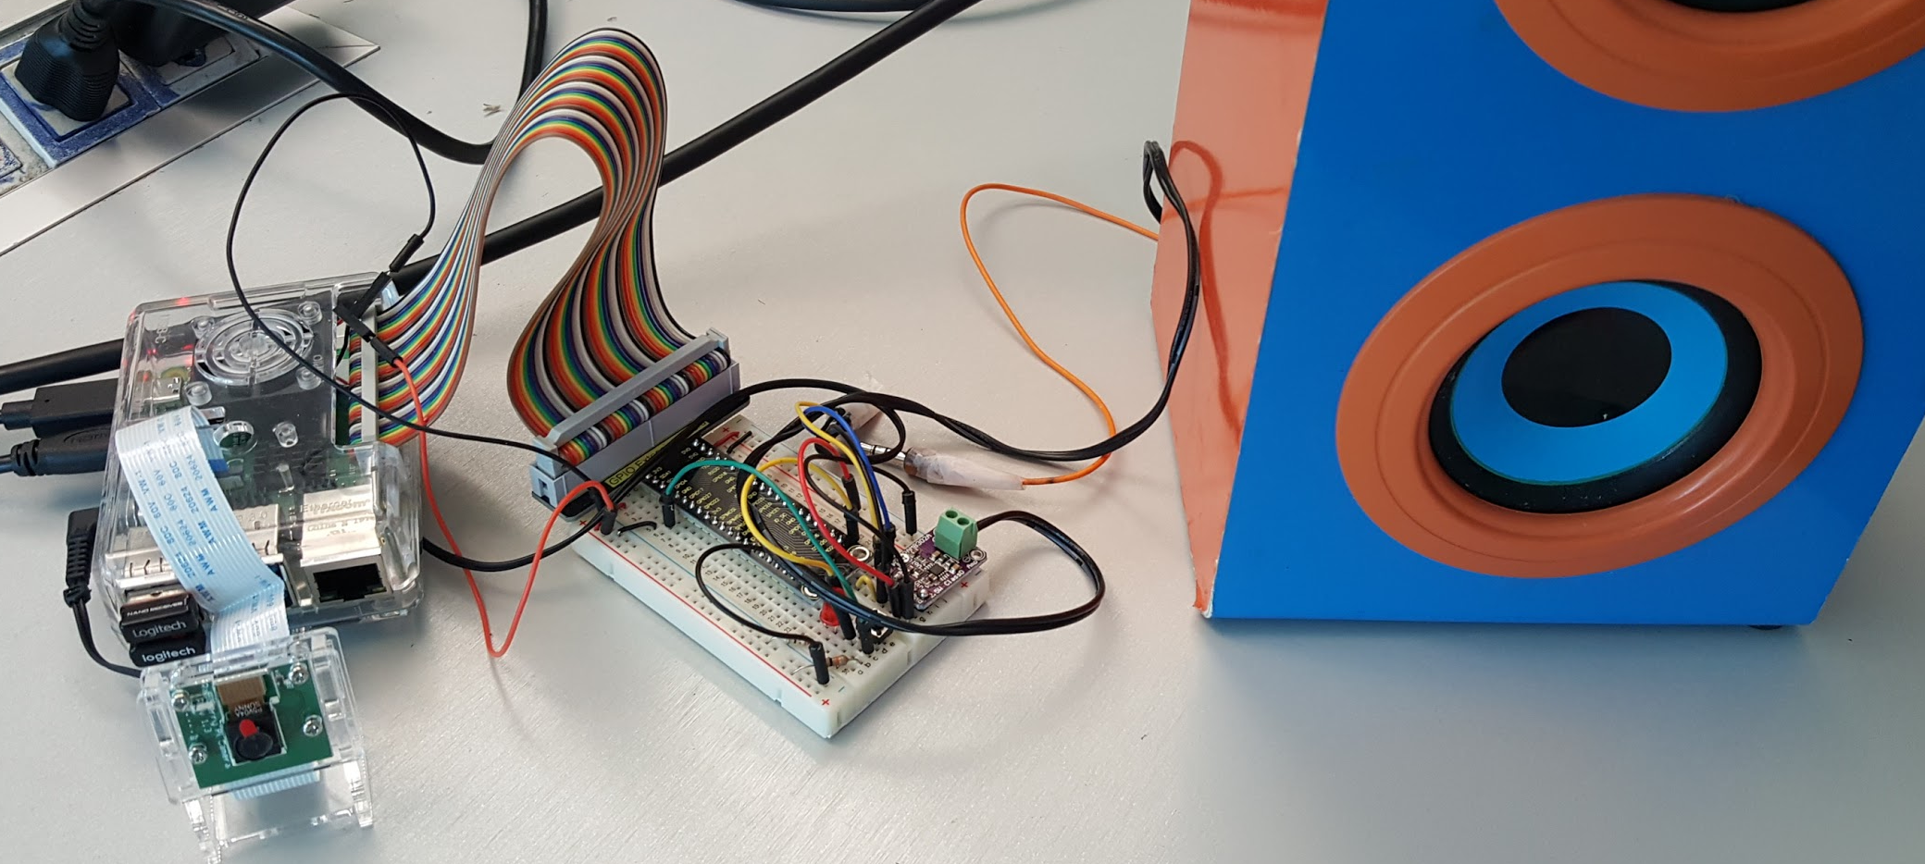
Physical Components
Raspberry Pi
Speaker
Amplifier
LED
Camera

Slide 7


IoT Integration
IBM Cloud Services
IBM Cloudant (Apache CouchDB)
IBM Watson IoT Platform
Node-RED, including Node-RED Dashboard
Email Service
Gmail

Slide 8
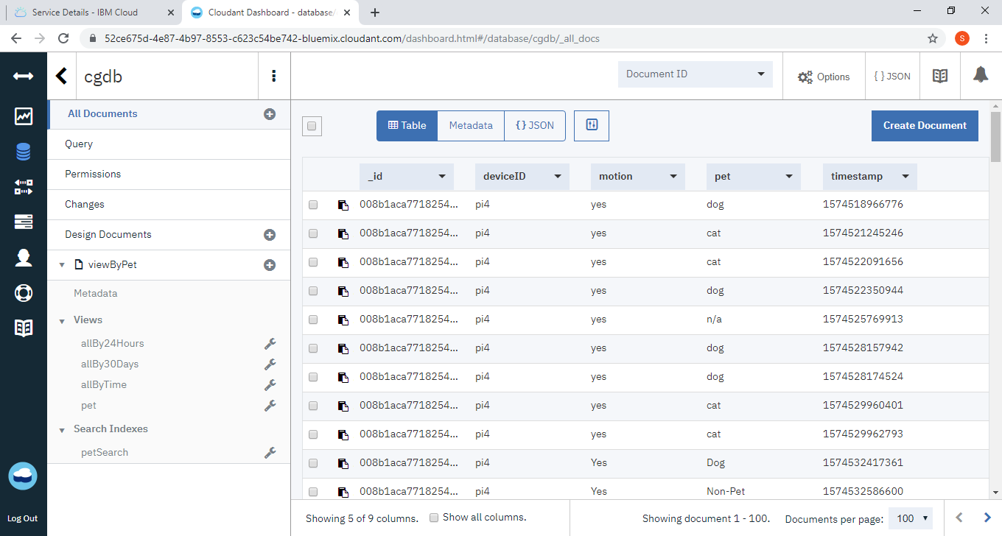
IBM Cloudant (Apache CouchDB)
Views (MapReduce)
Search Indexes

Slide 9
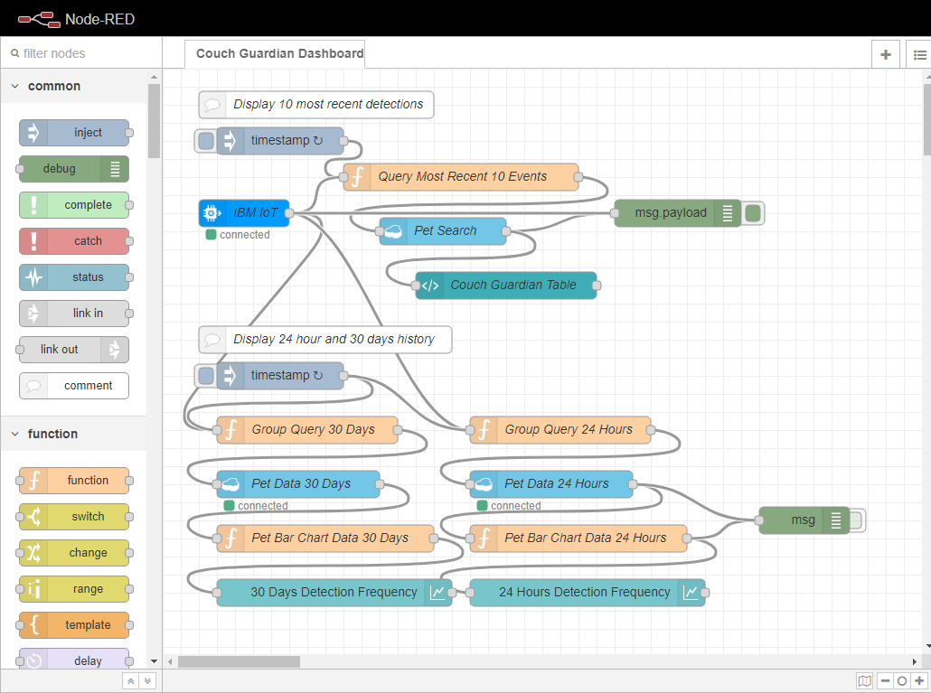
Node-RED
1. Monitor Signal from Watson IoT
2. Query IBM Cloudant Database
3. Process Data and Update Dashboard

Slide 10
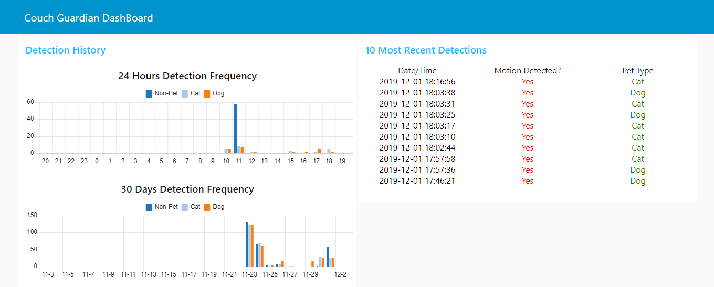
Node-RED Dashboard
https://cen5035group10.mybluemix.net/ui

Slide 11


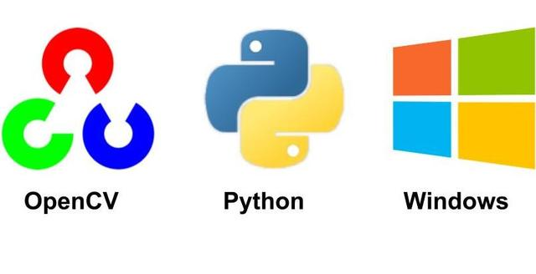
Software Structure
Written in Python using:
TensorFlow Lite -
Object Detection model
Ssd_mobilenet_v2_quantized_300x300_coco
Detects: Dogs, Cats, Tables, Couches, Chairs
OpenCV -
PiCamera and Image Processing
smtplib -
Python library for email

Slide 12
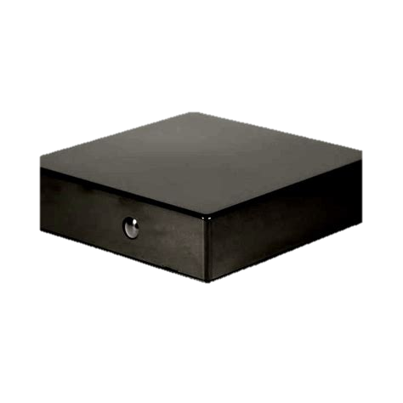

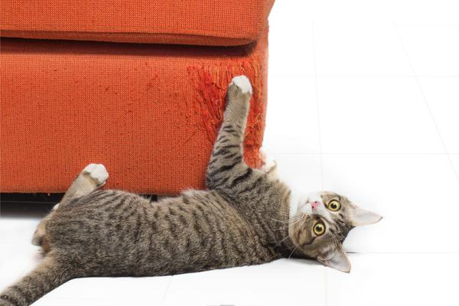
Device Features
Device placed in view of furniture to protect from pets
More than 3 feet from item for full view
PiCamera is actively identifying objects in view
If a cat or dog is identified AND is overlaps with a couch, chair, or table:
LED display on device notifies user that the device is active and working properly
Sound plays from connected speaker
Customized to pet type
Email sends to user with a picture of the pet in action
Log is sent to Watson IoT platform for Dashboard record
Dashboard illustrates progress in training pet to stay off of furniture

Slide 13
Features for the Future
Automated activation of detection program on startup
LED notification of established internet connection
Web-site created to provide additional user features:
Searchable photo and video storage
User account to setup email
Faster FPS Object Detection
Better trained pet behavior model
Wireless Bluetooth speaker link
Novelty connection to a more active deterrent for pets
Small flailing robot
Roomba that will follow pet)

Slide 14
Non-Functional Requirements
Usability
Device is capable of monitoring a large room, unobtrusively, without risk to pet or human
Reliability
Device identifies pets and furniture with 90% accuracy and issues sound and email notifications appropriately with little to no failure
Performance
Device can identify several entities within a single frame and perform a response within 5 seconds of logged activation
Supportability
Github repositories are maintained for multiple iterations of capability upgrades
Security
Email and Watson Dashboard credentials are non public entities

Slide 15


Lessons Learned
Remote collaboration has distinct challenges
Knowledge gaps
Scheduling concerns
Debugging with dependencies within modules and libraries
Developing new code and the organization needed

Slide 16
Thank you

